Slide 1

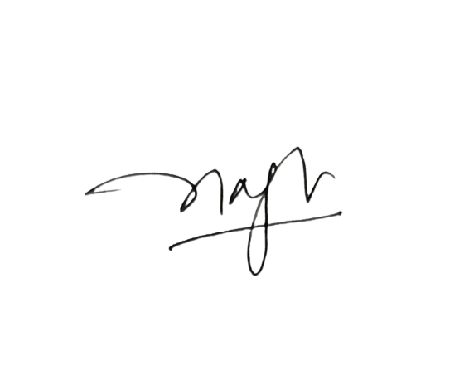
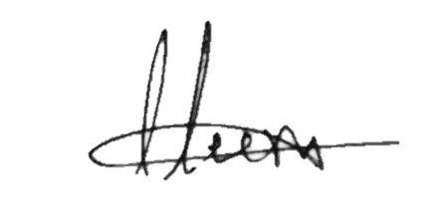
S.NO: ISM/IT/
INTERNATIONAL SCHOOL OF MANAGEMENT
Approved by AICTE (Ministry of HRD, Govt. of India)
CERTIFICATE
This is to certify that
of
has participated in the National on the occasion of International Yoga Day
on the theme
on
Program Coordinator
IQAC Coordinator

